Slide 1
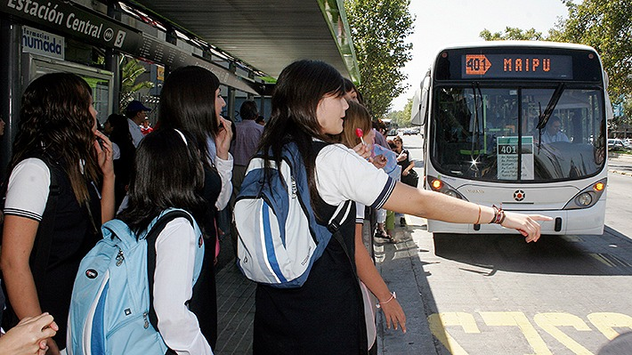



Understanding accessibility to education from the offer side:
(Spatial-rings analysis in Santiago, Chile)
International Choice Modelling Conference | Reykjavik, Iceland | May 23, 2022
Sebastian Astroza
Background image from https://www.emol.com/noticias/Nacional/2017/07/11/866292/El-22-de-los-escolares-chilenos-debe-trasladarse-a-otra-comuna-para-ir-al-colegio.html
Notes:
Complex Engineering Systems Institute (ISCI)
Center for sustainable urban development (CEDEUS)

Slide 2






Adrián Flores
Industrial Engineering
Universidad de Concepción
Daniela Robles
Industrial Engineering
Universidad de Concepción
Alejandra Rasse
School of Social Work
Pontificia Universidad Católica de Chile
Juan Antonio Carrasco
Civil Engineering
Universidad de Concepción
Felipe González-Espejo
Transport Engineering and Logistics
Pontificia Universidad Católica de Chile
Ricardo Hurtubia
Transport Engineering and Logistics
School of Architecture
Pontificia Universidad Católica de Chile

Slide 3
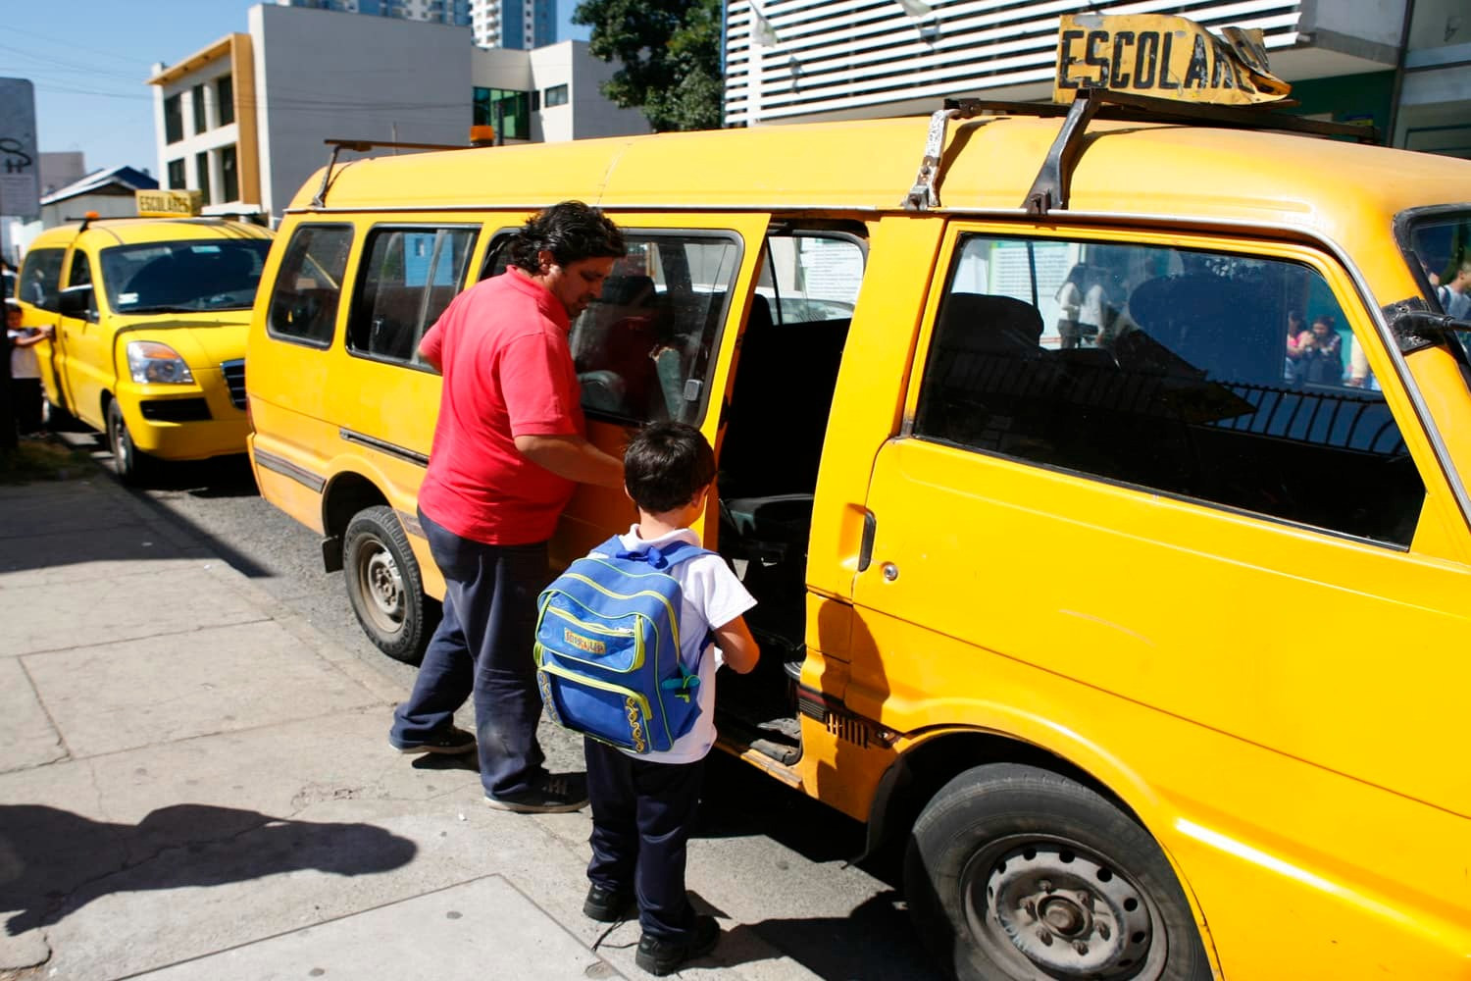
Presentation structure
Motivation
Data
Methodology
Results
Conclusions
Background image from https://www.supermadre.net/furgon-escolar/

Slide 4
Motivation

Slide 5
Education-voucher systems
Provide better quality education and more efficient school systems (Friedman, 1962; Hoxby, 2007; Levin, 2002).
Play a role on segregation mechanisms through education markets (Elacqua et al., 2006; Elacqua, 2012; Levin, 1998).
Free school choice → parents’ preferences and trade-offs become relevant (not restricted to geographical location’s school assignment).

Slide 6
Chilean (and Santiago’s) case
Nationwide voucher system implementation in the 1980s (Villalobos and Quaresma, 2015).
Recurrently criticized for its mechanisms that allow for discrimination and social segregation (Carrasco et al., 2021; Elacqua, 2012; Gayo et al., 2019; Valenzuela et al., 2014)
Similar to Friedman’s original work, no restrictions to the model in comparison to other countries’ implementations (Hofflinger et al., 2020).

Slide 7
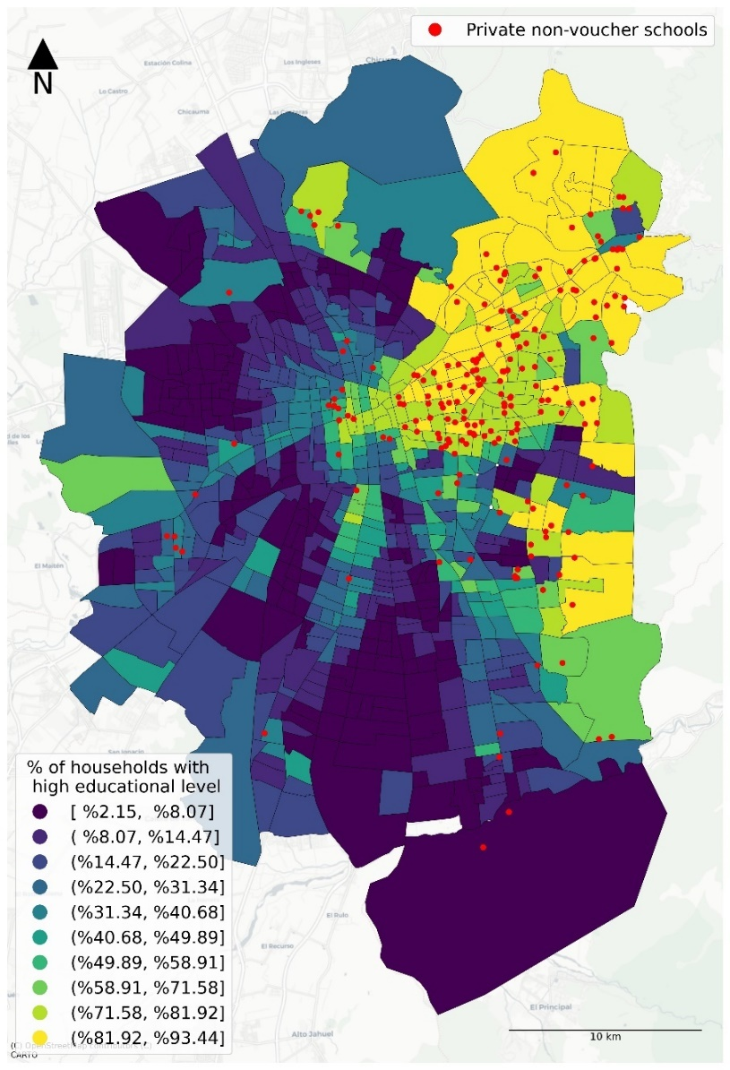
Figure 1: Private non-voucher school distribution and household's educational level distribution in Santiago, Chile.
Source: González-Espejo et al. (2022)

Slide 8
From the demand side
Parents’ role in the decision process vastly studied in the Chilean context.
Academic and location attributes affect a household's preferences towards regarding school choice (Chumacero et al., 2011; Gómez et al., 2012)
However, for several groups, socioeconomic aspects of the student body prevail over academic characteristics (Bellei et al., 2020; Elacqua et al., 2006), fostering social and spatial segregation dynamics.

Slide 9

From the demand side
There are families that “send” their kids to farther, more expensive, and lower quality schools only for the neighborhood that the school is located.
Screenshot from Chilean 90’s comedy sketch

Slide 10
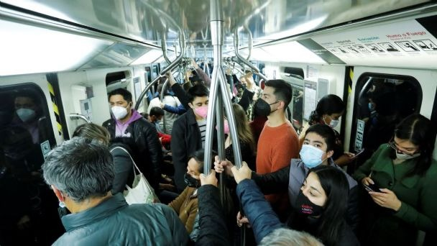
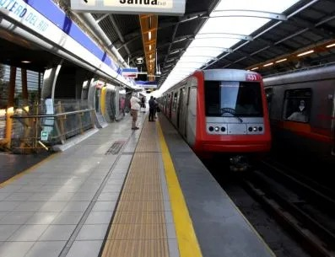
From the demand side
Spatially segregated city as income distribution strictly correlates with urban location (de Mattos, 1999).
School-related travel corresponds to 25% of the trips made at morning peak hour → half of them being made in motorized modes (SECTRA, 2014 : Origin-Destination Survey).

Slide 11
Our proposal
Take a look “from the offer side.”
Observation unit: school.
Methodology: spatial (or time) rings (“isochrons”)

Slide 12

More than 60 minutes by PT
Between 30 and 45 minutes by PT
Between 10 and 20 minutes by PT
Less than 10 minutes by PT
Between 20 and 30 minutes by PT
Between 45 and 60 minutes by PT

Slide 13
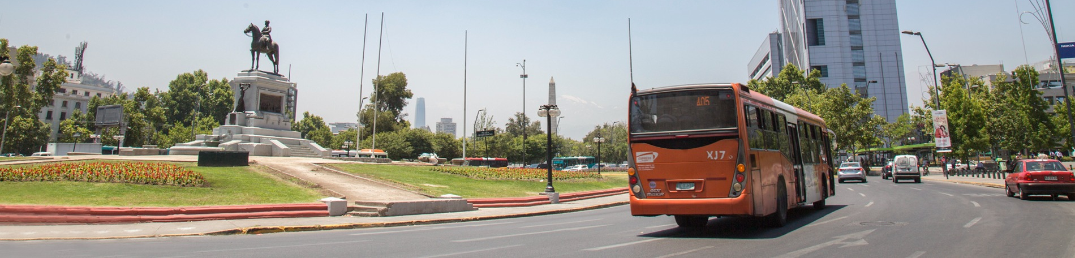
Research questions
Are there differences or patterns on the spatial distribution of the students’ locations attending each school?
What factors impact the spatial distribution of the students’ locations for each school?
Background image from https://www.homeurbano.com/es/chile-santiago/transportes/

Slide 14
Data

Slide 15
The sample
2016 enrollment data from the ministry of education.
456,817 students from 1,882 schools.
Type of institution | Sample | Real
Public | 31.19% | 21.17%
Private voucher | 55.90% | 61.93%
Private non-voucher | 12.91% | 16.90%
Enrollment | Sample | Real
Public | 28.98% | 25.44%
Private voucher | 65.79% | 61.27%
Private non-voucher | 5.23% | 13.29%
Table 1: Sample vs population
distribution of schools by type
Table 2: Sample vs population
distribution of enrollment by type

Slide 16
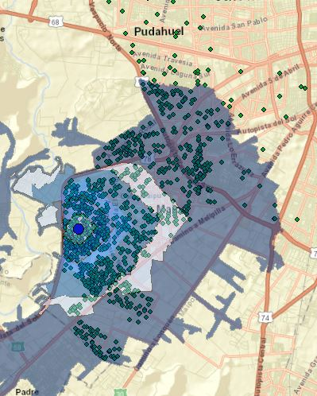
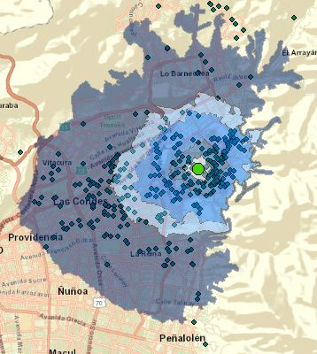
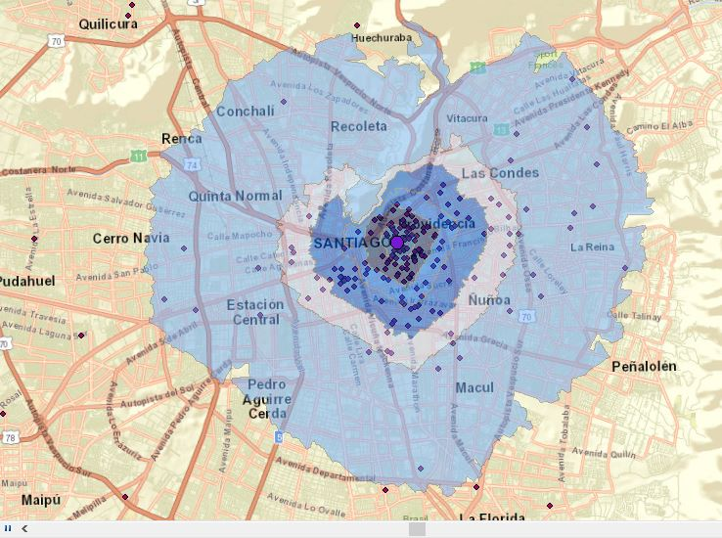
Examples
Liceo Nacional de Maipú
(public school)
Colegio Josefino Ssma Trinidad (private voucher)
Colegio Redland
(private non-voucher school)

Slide 17
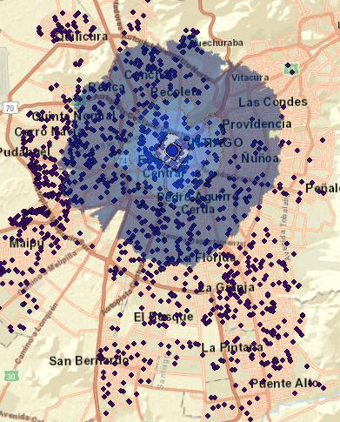
Examples
Instituto Nacional
(traditional public school with high performance)

Slide 18
Variables
Education level (elementary, secondary, both)
Dependency type (public, private voucher, private non-voucher)
Distance to city center.
Municipality.
School performance in SIMCE (Education Quality Measurement System)
Built environment.
Other school characteristics (number of teachers per student, religious status, extra-curricular infrastructure, etc.)

Slide 19
Methodology

Slide 20
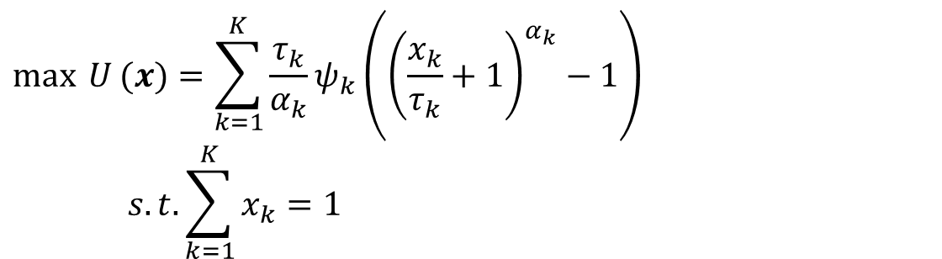
Multiple Discrete-Continuous Model
$$\text{max} U (x)=\sum_{k=1}^{K}{\frac{τ_{k}}{α_{k}}ψ_{k}\left({\left(\frac{x_{k}}{τ_{k}}+1\right)}^{α_{k}}−1\right)} \\ s.t. \sum_{k=1}^{K}{x_{k}=1}$$
K: number of rings (6 in our case)
x_{k}: % of student enrollment with residence in ring k
τ_{k}, ψ_{k} and α_{k} : parameters to estimate (with response heterogeneity and error)
Reference: Bhat (2008)

Slide 21
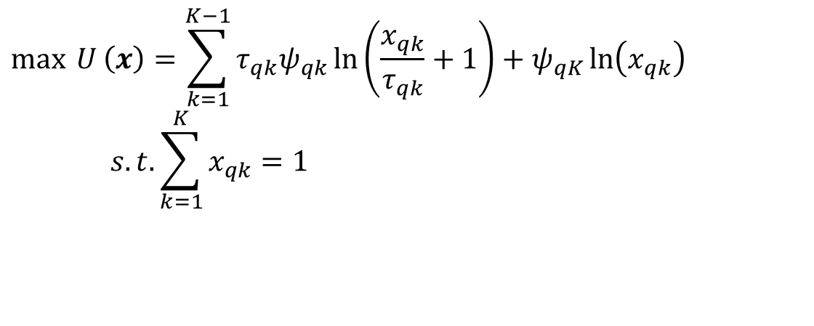
Spatial Multiple Discrete-Continuous Probit (S-MDCP) Model
K: number of rings (6 in our case)
x_{k}: % of student enrollment with residence in ring k
τ_{k}, and ψ_{k} : parameters to estimate
q: index for school (or educational institution)
$$\text{max} U \left(x\right)=\sum_{k=1}^{K−1}{τ_{qk}ψ_{qk}\ln\left(\frac{x_{qk}}{τ_{qk}}+1\right)}+ψ_{qK}\ln\left(x_{qk}\right) \\ s.t. \sum_{k=1}^{K}{x_{qk}=1}$$
Spatial Correlation
Reference: Bhat et al. (2015)

Slide 22
Results

Slide 23
Preliminary estimation
Schools with elementary education tend to have students more concentrated and near (less than 10 minutes)
Private non-voucher schools have less students living nearby (less than 20 minutes)
Providencia is a particular case: attract students from far away (many farther tan 60 minutes)

Slide 24
Preliminary estimation
Coed schools attract more students from nearby tan single-gender schools.
Schools with higher scores in SIMCE (Education Quality Measurement System) attract more students from farther rings.
Schools with betters acces to public transport (metro and buses) attract more students from farther rings.

Slide 25
Preliminary estimation
Spatial correlation is statistically significant and equal to 0.217
Proximity measure: 1 divided by distance (in km)

Slide 26
Conclusions

Slide 27
Conclusions
We can characterize the coverage area of each school.
It is possible to determine precisely the impact of each school and built environment characteristic.
There is evidence of a segregated city, even after controlling for many other factors.

Slide 28
Further Research
Testing different definitions of rings.
Expanding the model to other cities in the country.
Panel version of the model.
Other measures of “proximity” (competition)

Slide 29
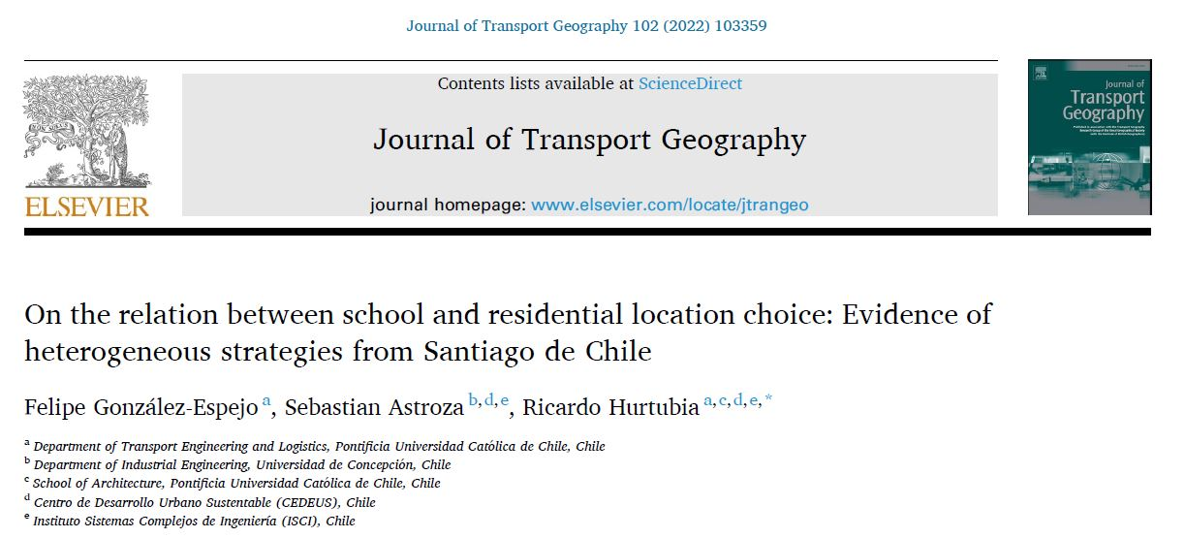


Slide 30
Questions?

Slide 31
Understanding accessibility to education from the offer side:
(Spatial-rings analysis in Santiago, Chile)
International Choice Modelling Conference | Reykjavik, Iceland | May 23, 2022
Sebastian Astroza
Background image from https://www.emol.com/noticias/Nacional/2017/07/11/866292/El-22-de-los-escolares-chilenos-debe-trasladarse-a-otra-comuna-para-ir-al-colegio.html

